Slide 2
Immigration Reform: Labor & Civil Rights Now!
Scott Frey, Director
Federal Government Affairs, National Office
Henry Garrido, Executive Director
District Council 37

Slide 3
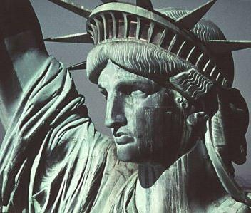
Nation of Immigrants
26% of U.S. immigrants or child of immigrants
47% have become U.S. citizens
Immigrants are 17% of workforce
About 11 million unauthorized immigrants

Slide 4
Undocumented
What percentage of undocumented immigrants have been in the U.S. more than 10 years?
a) 1/4
1/2
2/3
3/4

Slide 5
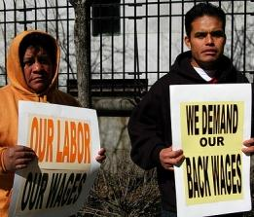
Undocumented at Work
Highest rates of wage theft, sexual harassment and death/injury
Constant threat of deportation
Keeps workers from asserting their rights

Slide 6
True or False
All immigrants have the legal right to organize into unions, regardless of work authorization
Immigrants without work authorization can get back pay and their jobs back if they are unlawfully fired for union activity

Slide 7
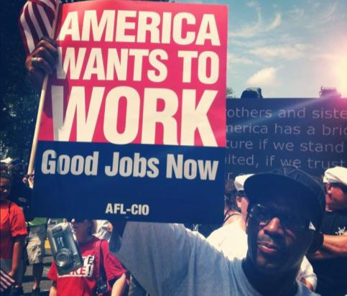
Impacts All Workers
Fear hurts union organizing
Workplace standards erode
Wages sink

Slide 8
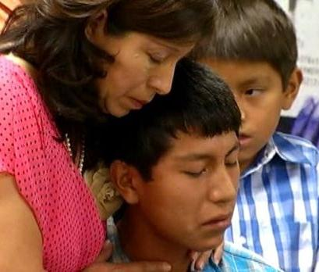
Humanitarian Concerns
Deportations destroy families
Crime reporting affected
Health care; other basic needs

Slide 9
Immigration System Broken

Slide 10
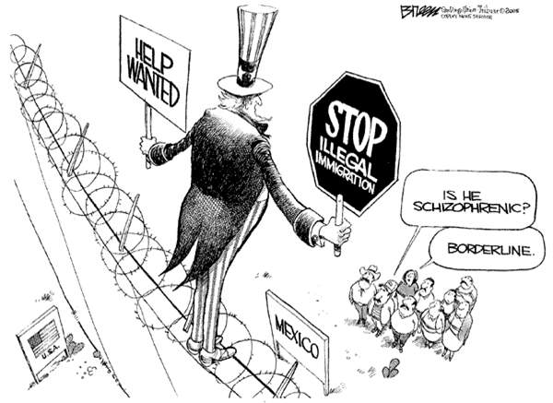
Mixed Messages

Slide 11
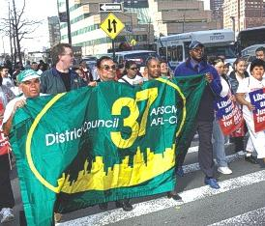
H-1B Visas
Needs reform, not expansion
DC 37 IT workers
Offshoring jobs

Slide 12
Enforcement
Congress: GOP-majority focus
Trump takes it further
DHS overreach

Slide 13
Obama Steps Up
Deferred Action for Childhood Arrivals (DACA)
How many DREAMers are no longer deportable?
400,000+
500,000+
600,000+
700,000+
Positive economic impact

Slide 14
DAPA/DACA+
Parents of citizens and LPR’s
Not deportable; Work authorization
More child immigrants eligible
Total: 4-5 million with “lawful presence”
Almost half of 11 million undocumented

Slide 15
Supreme Court Loss
4-4 decision
Upholds lower court injunction
Civil rights, economic justice suffers
Need ninth justice

Slide 16
Economic Impact of DAPA/DACA
Wages
Taxes
Jobs
GDP

Slide 17
Every day no DAPA/DACA+, $8.4 million GDP lost
Yearly gains in U.S. GDP from DAPA and expanded DACA, 2015 to 2024
GDP lost each year that DAPA and expanded DACA are not implemented

Slide 18
Prospects for CIR
Need Comprehensive Immigration Reform
Labor / Immigrant Rights Groups Redouble Efforts
- San Diego Immigration Table
- Civic Engagement
- Elections

Slide 19
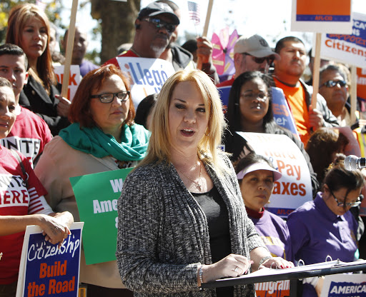

Slide 20
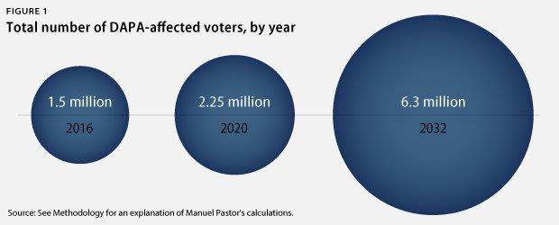
DAPA Elections Impact

Slide 21
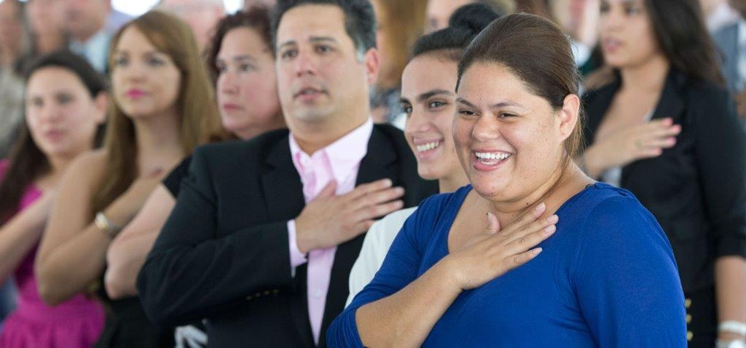
November 2016
Clinton v Trump
Unlock power of Latino and immigrant vote
8.8 million LPR’s eligible to become citizens
Cities; immigrant rights groups; unions; media

