Slide 1
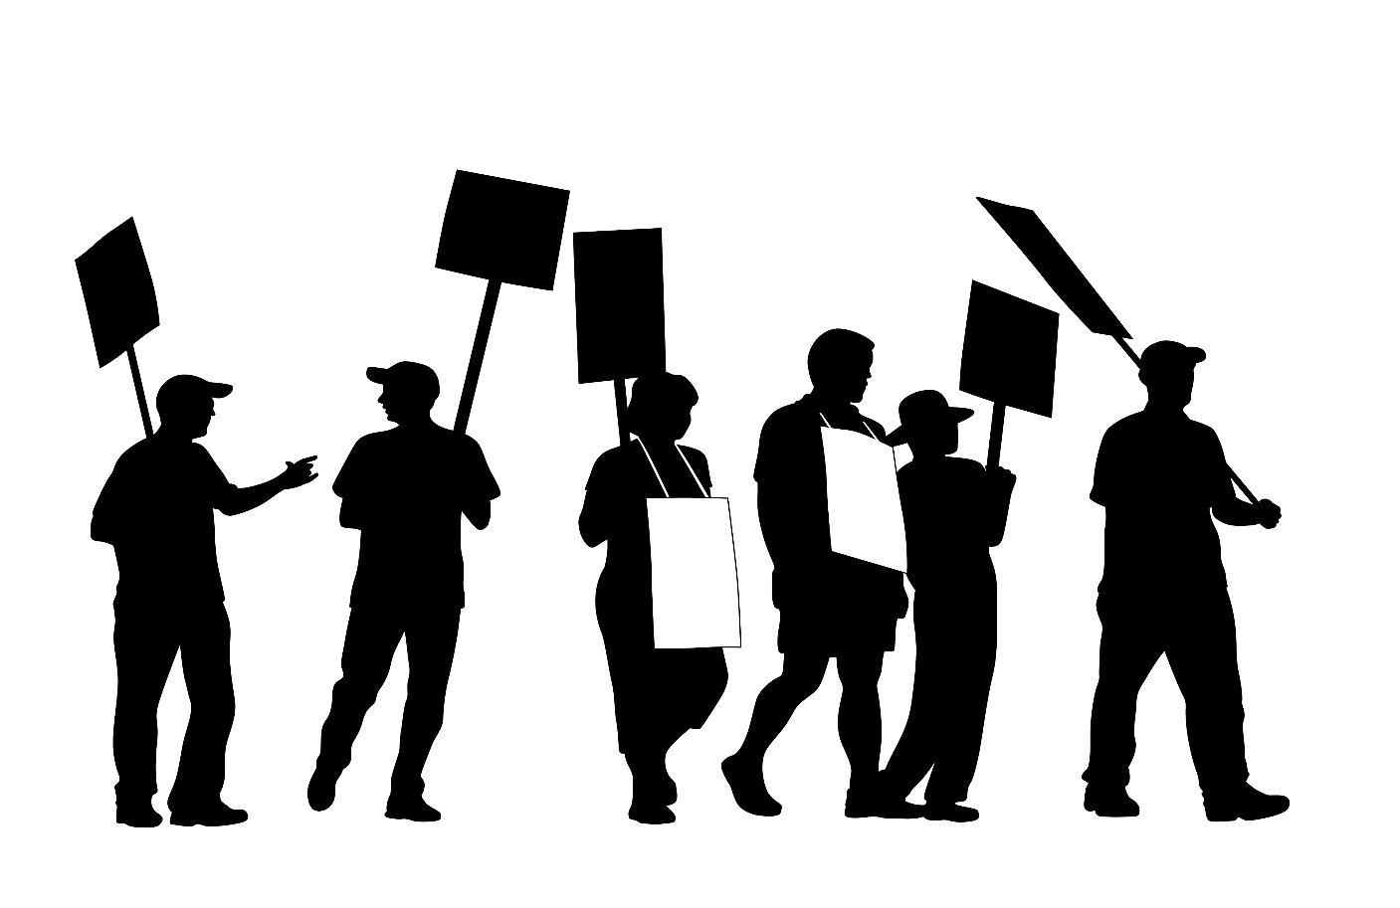
We Must Demand Safety & Health Protections
When We Fight, We Win!
Notes:
Advocacy (noun): The act of pleading or arguing in favor of something, such as a cause, idea, or policy; active support.
Nearly all of us have supported a political candidates an election. But issue based advocacy is a bit different, this is a process to pressure elected and government officials into creating regulations that favor working people. Ultimately, there is no right or wrong way to advocate for an issue, the name of the game is pressure, pressure, pressure! So choose your favorite tactic and start advocating.
In an advocacy campaign the people set the agenda, form coalitions, try to gain media presence and woo elected officials into supporting the issue at hand.
Advocating for an issue takes time and commitment. When lawmakers wont take a stand for working people it is our job to move the marker, our lives depend on it.

