Slide 2
Rulemaking Ain’t Just For Lobbyists
Keith Wrightson
Health & Safety Specialist
OSHA has proposed new rules on workplace violence prevention but we cannot wait a day longer for protections on the job.

Slide 3
OSHA has Started the Process to Create New Rules on
Notes:
Department of Labor ( DOL ) RIN: 1218-AD08
Occupational Safety and Health Administration ( OSHA ) Publication: 201604
Title: Preventing Workplace Violence in Healthcare
Abstract:
The RFI will provide OSHA's history with the issue of workplace violence in healthcare, including a discussion of the Guidelines that were initially published in 1996, a 2014 update to the Guidelines, and the recently published tools and strategies that were shared with OSHA by healthcare facilities with effective violence prevention programs. It will also discuss s the Agency's use of 5(a)(1) in enforcement cases in healthcare. The RFI solicits information primarily from health care employers, workers and other subject matter experts on impacts of violence, prevention strategies, and other information that will be useful to the Agency if it decides to move forward in rulemaking. OSHA will also solicit information from stakeholders, including state officials, employers and workers, in the nine states that require certain health healthcare facilities to have some type of workplace violence prevention program.
Agency Contact: William Perry
Director, Directorate of Standards and Guidance
Department of Labor
Occupational Safety and Health Administration
200 Constitution Avenue NW., FP Building, Room N-3718
Washington , DC 20210
Phone: 202 693-1950
FAX: 202 693-1678
E-Mail: perry.bill@dol.gov

Slide 4
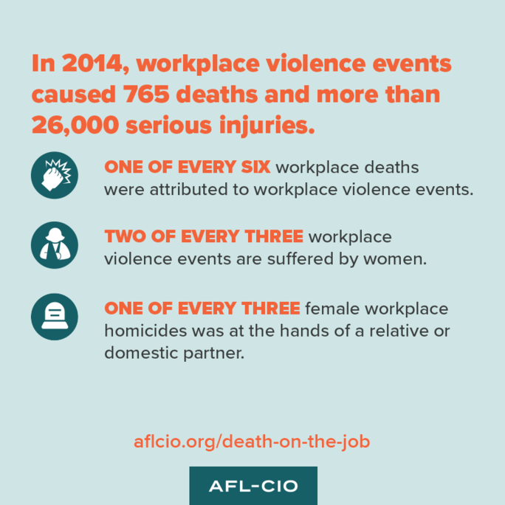
A National Epidemic
Notes:
Fatal work injuries due to violence and other injuries totaled 749 deaths in 2014 (16 percent of all workplace deaths).
During 2014, workplace suicides represented 271 deaths.
Workplace homicides in which women were the victims, the greatest share of assailants were relatives or domestic partners (32 percent) in 2014.
Also during 2014, workplace homicides involving male assailants were the most common type (33 percent).
http://www.aflcio.org/Issues/Job-Safety/Death-on-the-Job-Report

Slide 5
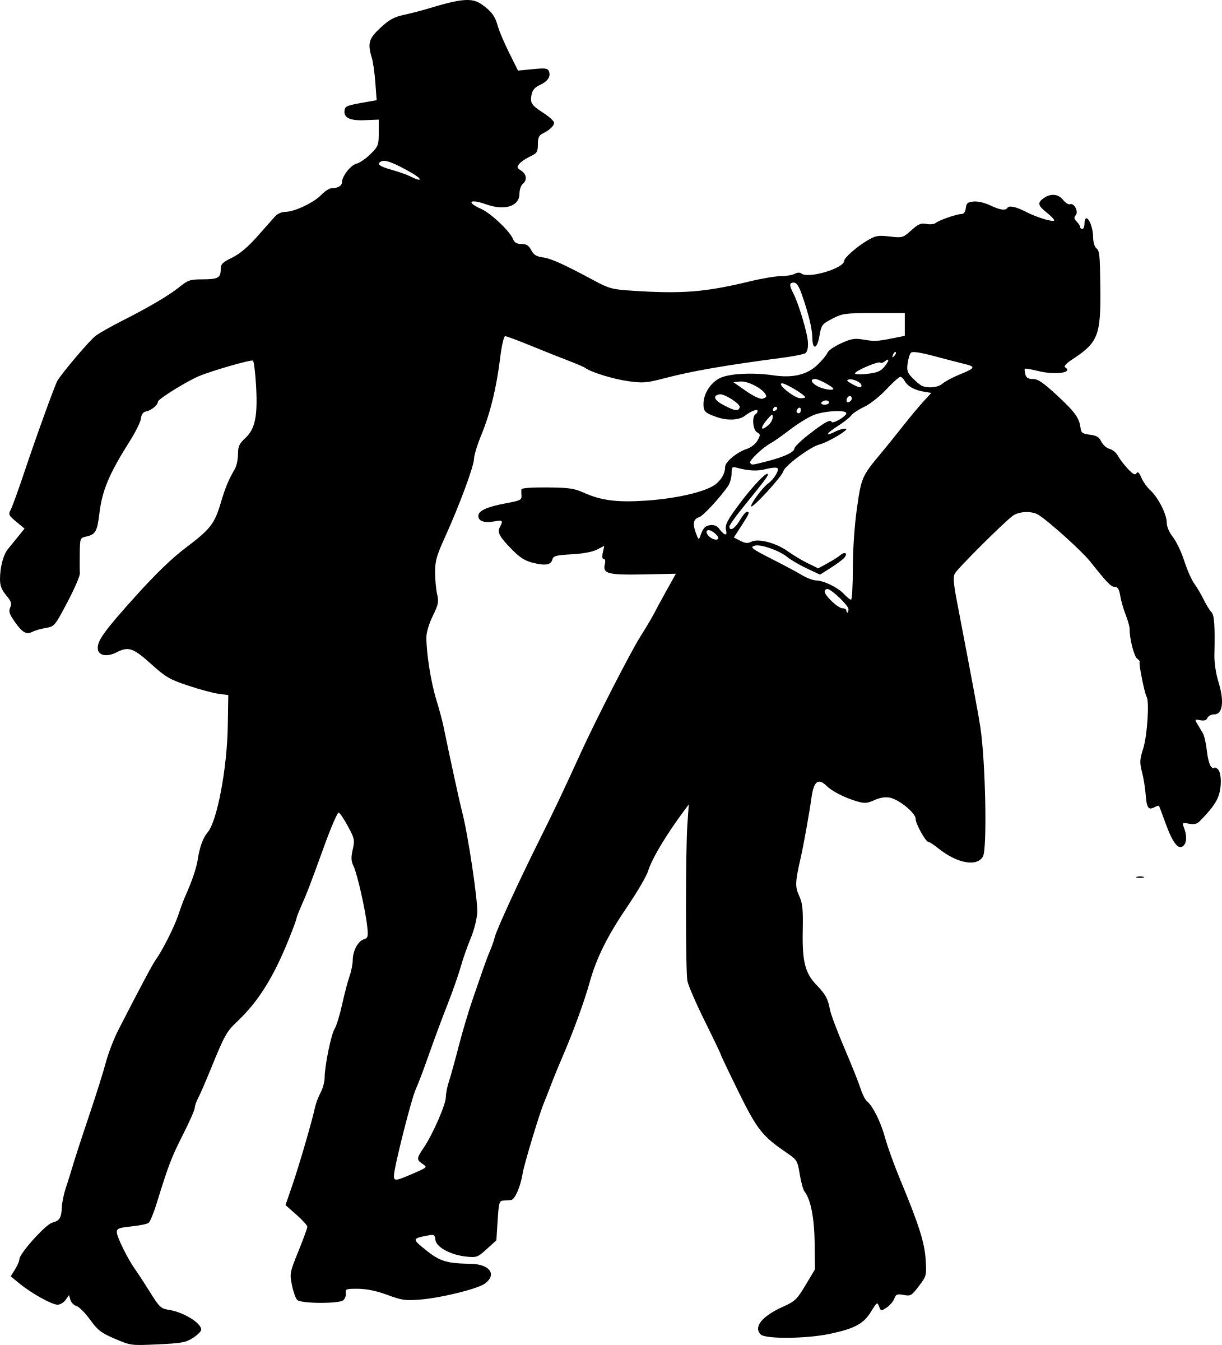
What is Workplace Violence?
Workplace violence is any physical assault, threatening behavior, or verbal abuse occurring in the work setting.
Notes:
Types of Workplace Violence
It is the position of AFSCME that:
Beatings, stabbings, suicides, shootings, sexual assaults, attempted-suicides, psychological traumas, threats , obscene phone calls, intimidation, harassment, stalking, bullying, and shouting are all incidents of workplace violence.
Have you ever experience workplace violence? What happened?

Slide 6
The Rulemaking Process
Notes:
The rulemaking process is complicated, we know! What is important to remember is that at every step in this process the public is given opportunity to engage in the process.
Why do you think that the process is complicated?

Slide 7
OSHA Wants to Hear From You!
Notes:
Just because you do not live in Washington, D.C. does not mean you do not have a means to participate in the rulemaking process. OSHA has 10 Regional Offices across the nation and 26 additional state level offices. OSHA Contact: https://www.osha.gov/html/RAmap.html
Have you ever contacted OSHA? Why?

Slide 8
We Must Insert Ourselves in the Rulemaking Process
When We Fight, We Win!
Notes:
Advocacy (noun): The act of pleading or arguing in favor of something, such as a cause, idea, or policy; active support.
Nearly all of us have supported a political candidates an election. But issue based advocacy is a bit different, this is a process to pressure elected and government officials into creating regulations that favor working people. Ultimately, there is no right or wrong way to advocate for an issue, the name of the game is pressure, pressure, pressure! So choose your favorite tactic and start advocating.
In an advocacy campaign the people set the agenda, form coalitions, try to gain media presence and woo elected officials into support the issue at hand.
Advocating for an issue takes time and commitment. When lawmakers wont take a stand for working people it is our job to move the marker, our lives depend on it.

Slide 9
Where Do You Fit in the Puzzle?
Notes:
Not everyone will be willing to join for rallies, or write letters to Congress and OSHA. But yet, there is a place for everyone in this action.
What will you do to participate in the workplace violence prevention rulemaking?

Slide 10
Ideas Into Action
Meet
Seek out workplace leaders
Build support
Plan
Choose your tactics
Draft an agenda
Engage
Move into action
Never quit!
Notes:
Meet
Every workplace has leaders. Convening a group of leaders and members to explain why this action is necessary is an important first step. Once the workers have “bought in” to changing workplace conditions and improving their lives you can move to the next step.
Plan
Setting an agenda can be difficult at times when there are many safety and health issues to be addressed. In this exercise we have one collective goal: new regulations to protect us against workplace violence. Choose your tactics carefully, each tactic should be used to build on the previous success. Start small with a letter to OSHA expressing your concerns on violence in the workplace. Then build momentum and host a workplace awareness day, write op-ed’ s to your local newspaper, hold a rally at OSH’s offices, contact your Congressional figures, form a response team fro when violence occurs and stay vigilant. The list of tactics is endless.
Engage
Advocating for an issue takes time and commitment. It is not easy, but we are AFSCME and we Never Quit! Coordinating in your workplace can be a fulltime job. It is important to appoint a “lead” to get everyone on the same page and to move everyone into collective action. When we stick together, we win!

Slide 11
Small Group Activity
Notes:
Each group will brainstorm though 1 of 3 assigned areas to participate in rulemaking from the previous slide. Each group will assign a note taker and a spokesperson to report back to the larger group when the activity is complete.
Meet
How will we identify leaders and members? How will we build support in the workplace for this rulemaking?
Plan
What can we do to participate in the rulemaking? What tactics can we explore?
Engage
Who can be the assigned coordinator in the workplace? How often do we want to engage in tactics? Will they be planned or will we respond to an event that will likely get us media coverage?

Slide 12
Be the Change, Lead the Change
Email:
SafeJobsNow@AFSCME.org
Notes:
Send an email to SafeJobsNow@AFSCME.org and let us know that your interested in helping with the rulemaking on workplace violence. We will add you to our special group of AFSCME Advocates. From time to time we will send out tips, tricks and thoughts on how OSHA is proceeding with creating the new rules.
We will also start to think of ways where we as members can acted together in a coordinated effort across the nation to influence the rulemaking process.
I hope you consider joining us! Our lives depend on it.

