Slide 2
Ergonomics
Debra Sung, MSPT
Support and Circulation for a
Health Body

Slide 3
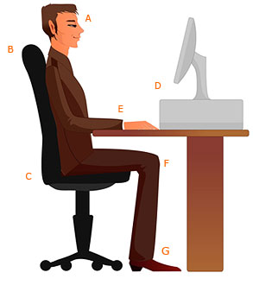

Slide 4
Posture Counts
A: Eyes looking slightly downward, chin tucked
B: Back supported, lumbar cushion
C: Sit back in seat
D: Monitor 18-24 inches away

Slide 5
Posture Counts
E: Elbows 90 degrees, wrists neutral
F: Hips and knees at 90 degrees, open area behind knees
G: Feet supported (Adjustable chair- may need to adjust computer/table height)

Slide 6
Resources:
Ergonomics-info.com
Http://www.m.webmd.com/fitness-exercise/features/exercise-at-your-desk
Greatist.com – Search for Deskercise!

