Slide 1
So You Want To Run For Office
The Phases of a Successful Campaign

Slide 2
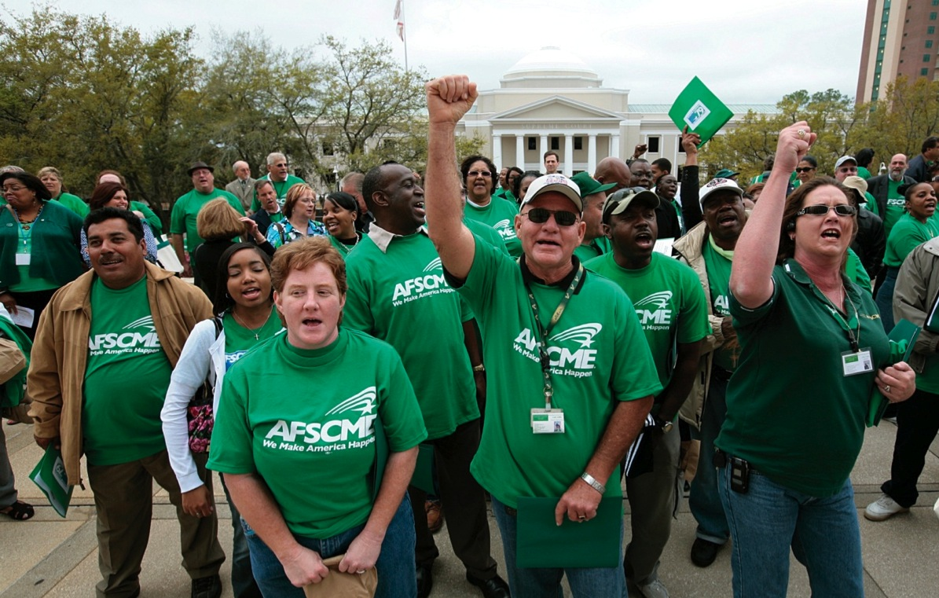
Why Run for Office?

Slide 3
Hold Politicians Accountable
Political Action is 365 Days a Year:
Link political action to our state battles.
Grow and support our own candidates.
Connect politics and organizing.
Educate and mobilize AFSCME members and the general public to vote.

Slide 4
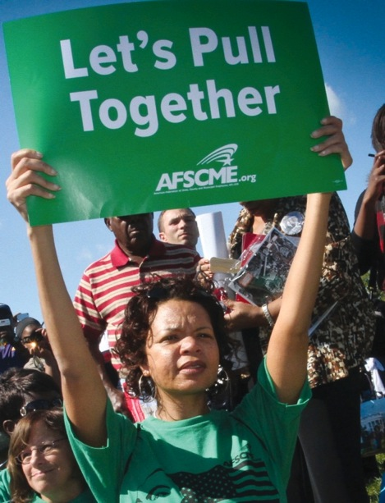
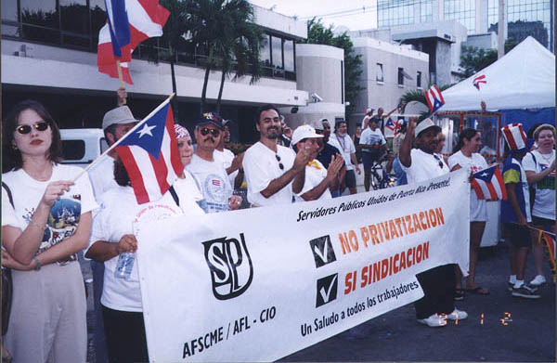
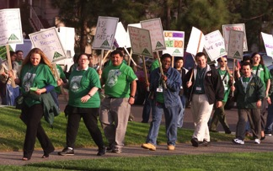
Build Member Involvement

Slide 5
Getting Ready
Why run?
What can you offer?
Can you win?
Who will support you?
Can you raise the necessary funds?
Do you have the stamina, the discipline, the vision you need to win?
Notes:
Why do you want to run?
What can you offer voters?
Is your district winnable?
Can you build a coalition of supporters?
Can you raise the money essential for winning?
Do you have the stamina, the discipline and the vision needed to win?
Self analysis- am I ready? What do I bring? What do I need in my life to make this work?
Family- Are they ready? Will they help? Sisters-
Co-Workers- Job, will they be supportive or not- have I saved enough money to be unemployed
Self-Research, voting records, personal history
Getting ready to run box-and List collection - more about that later
Get in Shape, eat, sleep, water

Slide 6
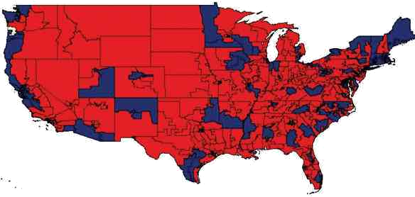
Collect and Analyze Data
What does the district look like?
Past elections
Likely opposition
Deadlines and requirements
Cost to run
Likely Donors
Campaign finance laws/limits
Voter file access

Slide 7
Get Out of Your Comfort Zone
Expand your base
Attack your weaknesses
Grow community involvement
Raise your profile

Slide 8
The Elements of a Campaign Plan
What needs to be done?
Who will do the work?
When will the work happen?
How much will it cost?
Why is it necessary to win?

Slide 9
Put Together Your Team
Campaign Treasurer
Campaign Manager
Field Director
Digital Director
Communications Director
Volunteer Coordinator
Fundraiser
Scheduler
Policy Researcher

Slide 10
Budget Rules
Budget Rule #1: Create a realistic budget
Budget Rule #2: The budget must reflect the campaign’s priorities
Budget Rule # 3: Minimize overhead; maximize voter contact
Budget Rule #4: Pay your bills
Notes:
Budget Rule #1: Create a realistic budget. It is as critical as the written plan, and is a key part of the plan. Like the plan, it can and will change.
Budget Rule #2: It must be designed to reflect the priorities of the campaign. Look at your targets for persuasion, and spend the money on those targets.
Budget Rule # 3: Minimize overhead; maximize voter contact and field organizing. Learn to say “No.” See rule #2. Does it help you persuade your targets?
Budget Rule #4: Pay your bills and try to avoid debt.

Slide 11
Fundraising
How much do you need to win?
Daily, weekly, monthly goals
Direct mail, events, call time goals
Cash flow based on your plan & calendar

Slide 12
Build Contact List
Your church congregation directory
Facebook friends
Twitter followers
Everyone invited to your wedding
Attendees from every conference, meeting, gathering you attend
Employee directory
Alumni associations
Neighborhood association
Professional societies
Client list
Business card file
Holiday card list

Slide 13
Message Development & Delivery
Self and Opposition Research – Contrast
Your campaign’s central theme?
Consistent message
fundraising, mail, phones, earned & paid media
Repetition is key!

Slide 14
Paid Media
Direct mail is top priority
Budget for as much broadcast media as you can afford, after direct mail
Dominate at least 1 medium
Respond to attacks (if necessary) in the medium in which you are attacked

Slide 15
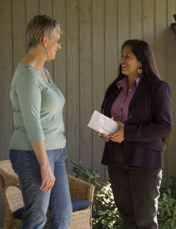
Direct Voter Contact – Field
Know your Win number
Electoral Environment and Targeting
Voter Registration
Voter ID
Persuasion
Base Building
Visibility
GOTV

Slide 16
Voter Contact
Doors, Doors and More Doors
Direct Mail
Phone calls
SMS and Email
Getting you and your message to the voters over and over
70-80% of your budget goes to voter contact and paid media

