Slide 2
Bring It On Home: Winning Back Outsourced Work
Several AFSCME Locals Have Won Back Outsourced Work
How Did They Do It?
Are There Key Steps That Successful In-Sourcing Campaigns Have in Common?
How Have Successful Approaches Differed?

Slide 3
Why Does The Public Sector In-Source Contracted Work?
The Two Main Reasons Given for In-Sourcing:
The Services Provided Are Inferior
Promised Cost Savings Aren’t Delivered
Can Social Justice Be Another Reason?

Slide 4
Jersey City Public Schools: Can We Partner With Management?
Bill Murawski President-Local 2262

Slide 5
Jersey City Schools
Successfully Fought Against Outsourcing of School Security
Winning That Fight Allowed Local to Argue They Could Do Outsourced Work Cheaper Than Current Contractors

Slide 6
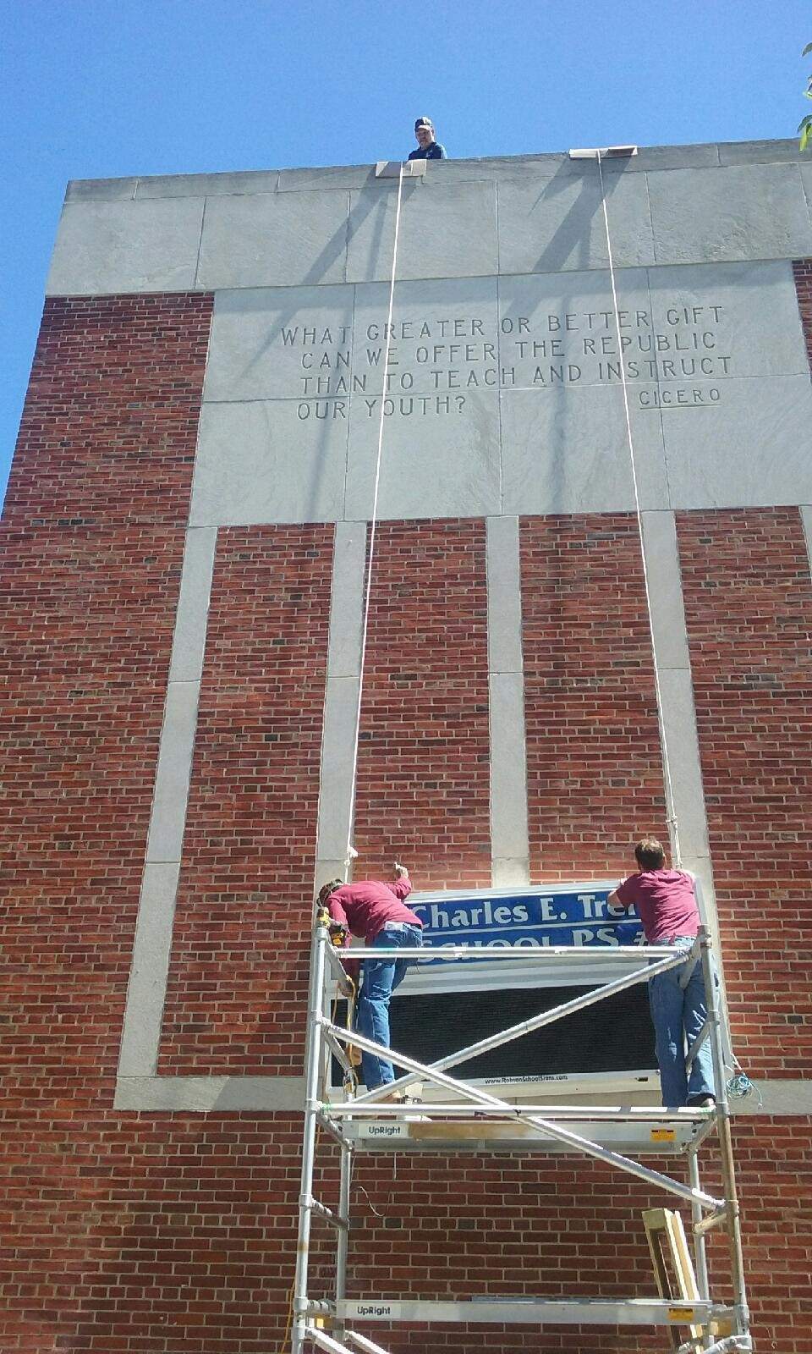
Previously Contracted Work Now Done By Local 2262

Slide 7
University of California: How Do We Deal With Management Unwilling to Partner With Us?
Liz Pearlman- Executive Director Local 3299

Slide 8
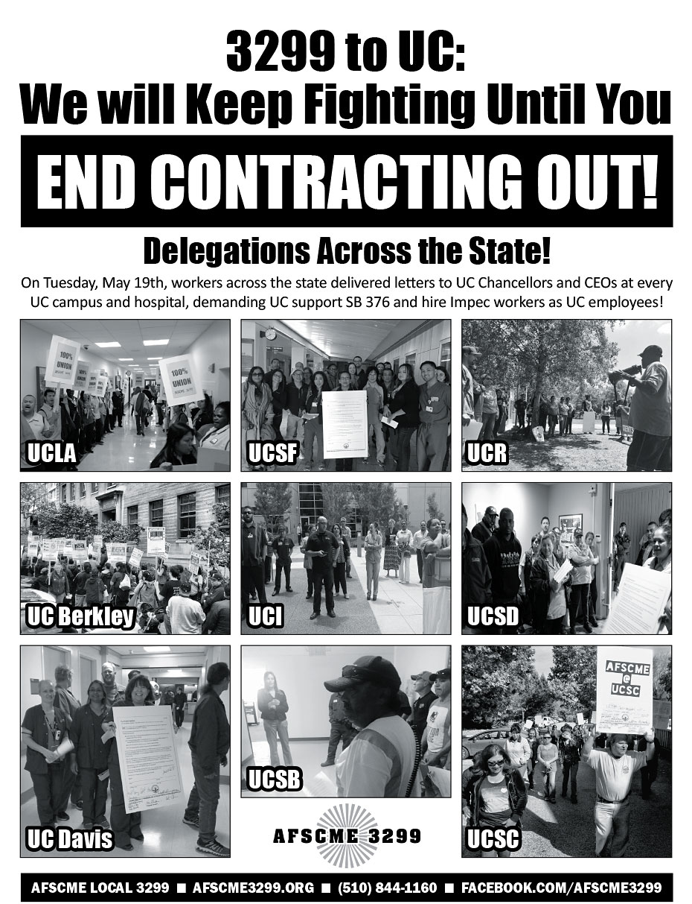

Slide 9
University of California System
3299 Has Successfully Pressured the University System to In-Source:
Custodians
Parking Attendants
Food Service
Facility Management and More
All In-Sourced Workers Immediately Eligible for Higher Wages and Better Benefits

