Slide 1
Be Well/Stay Strong!

Slide 2
Keep It Simple
Make healthy eating choices.
Get regular exercise.
Know your health risk factors.

Slide 3
Let Your Colors Show
When you vary the colors of veggies on your plate, you add more nutrients. Mix your greens, yellows and red veggies for the healthiest eating.

Slide 4
Sweet Treats
Fruit makes an excellent snack or dessert
Tip: If you generally hit the vending machine in the afternoon, keep dried fruits that will last like apricots or raisins with you at work, so you can have a healthy treat instead.

Slide 5
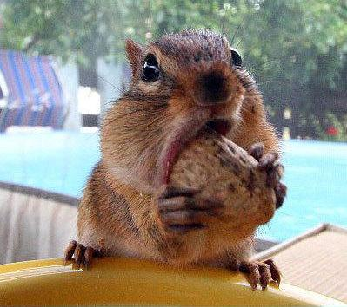
Nuts to You!
Munch a handful of nuts for a burst of energy – they’re packed with protein.
Nuts are rich in Omega-3 for heart health.
Just 100 calories of nuts in the morning can prevent you from taking in 75 empty calories later in the day, because nuts are high in fiber to help you feel full.

Slide 6
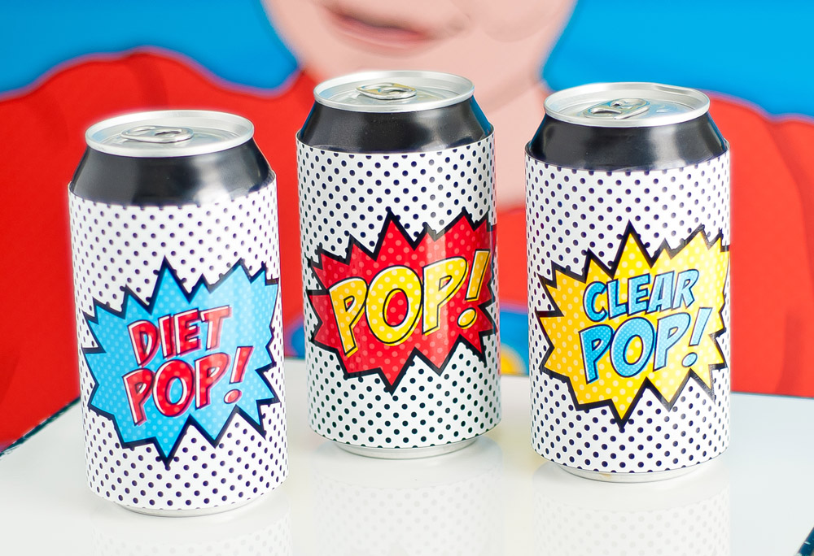
Eat Your Calories – Don’t Drink Them
Sugar-sweetened drinks are linked to obesity, Type 2 diabetes and heart disease.
Even some fruit juices have added sugar, so eat fruit instead-- plus you’ll get fiber.
Just cutting back on the number of sodas consumed in a week can have health benefits.

Slide 7
Hydration/Hydration/Hydration
Las Vegas temperature in July averages 104 degrees, so drink water to stay hydrated.
Dehydration happens fast -- don’t wait until you feel thirsty to drink water.

Slide 8
Make Mine a Triple
Double the amount of water you drink at home to avoid dehydration in the Vegas heat.
Alcohol dehydrates, so if you’re hitting the bars, triple the amount of water you drink.

Slide 9
Sun Safety
UV radiation is linked to skin cancer and premature skin aging, so use sun protection between 10 a.m. and 4 p.m.
Wear a hat with wide brim to cover your face/neck.
Use sunscreen with SPF 15 or higher.

Slide 10
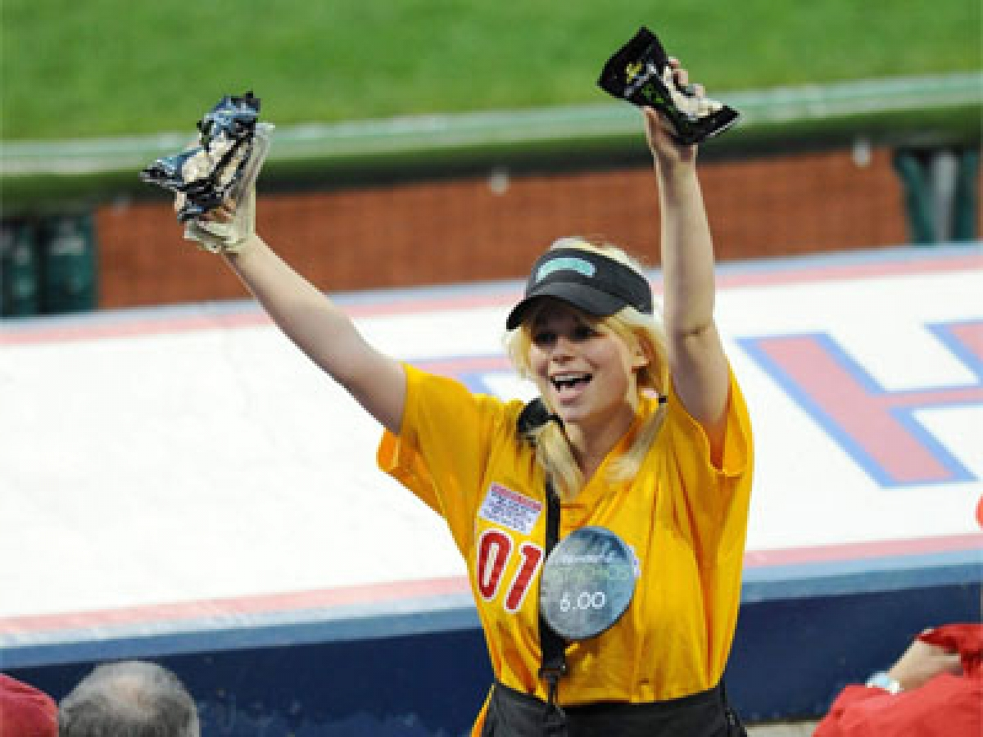
Sunscreen! Get your sunscreen here!
Apply sunscreen 30 minutes prior to going outside, to get the maximum benefit.
If you forgot your sunscreen, come inside to get some.

Slide 11
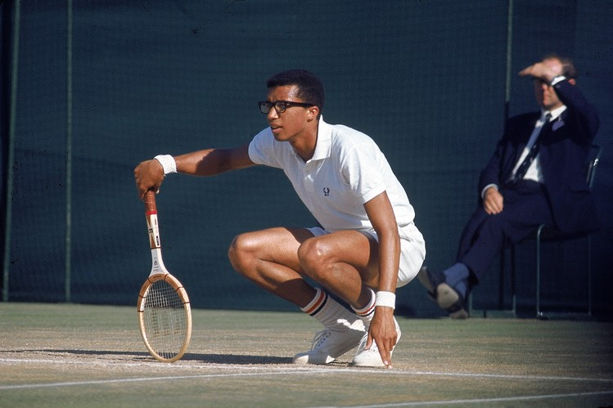
Everyone can exercise
“Start where you are. Do what you can.”
Arthur Ashe on fitness

Slide 12
Step It Up!
Just 30 minutes of brisk walking every day can have a significant health impact.
Make it easy – Incorporate walking into your daily routine.

Slide 13
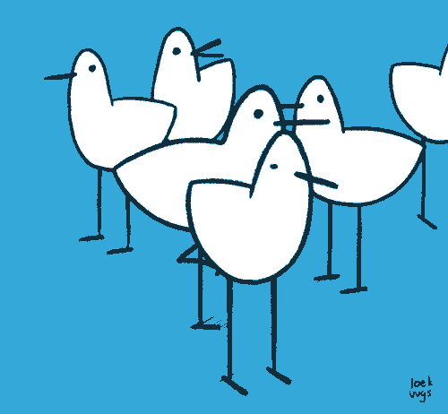
One small step for man, one great step for AFSCME
Bring your lunch to work and take a walk at lunchtime.
Go for a neighborhood walk after work with family or friends, to catch up.

Slide 14
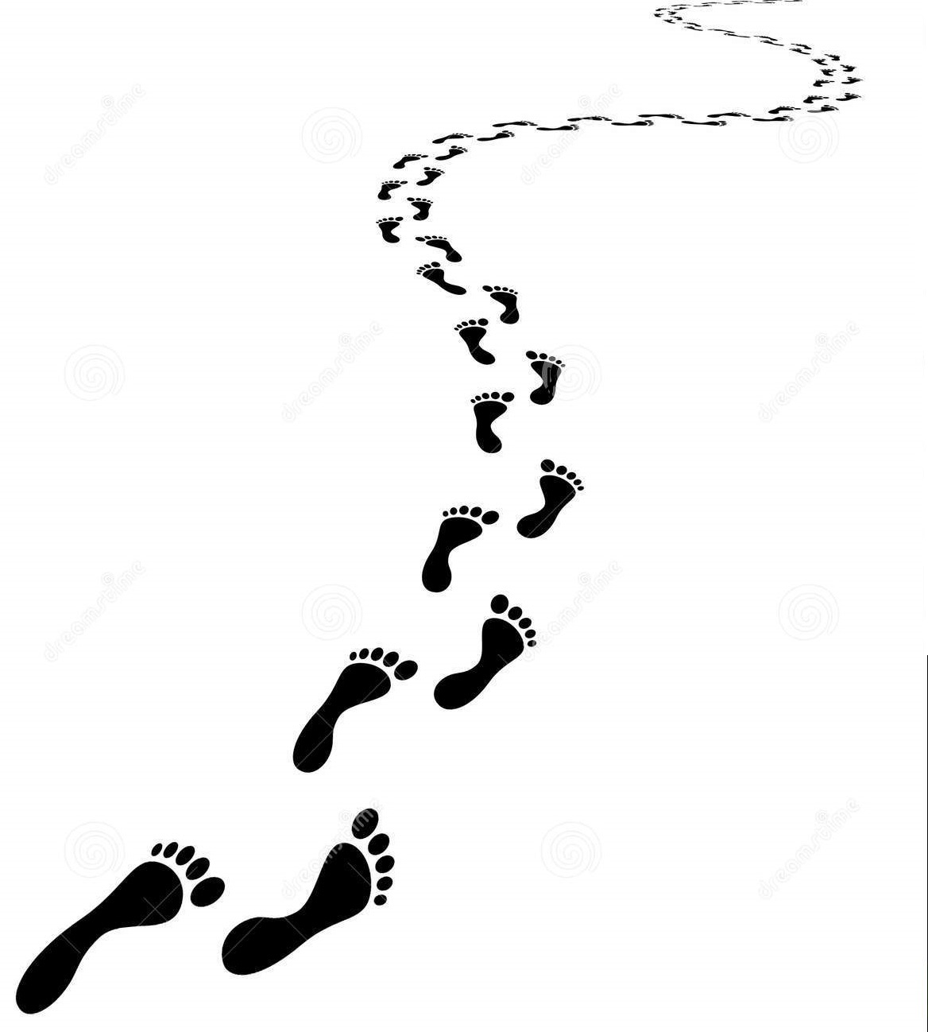
A journey of 1,000 miles starts with one step
Park farther from store or mall entrances and walk the extra steps.
Hold a walking meeting at work – you think better when blood and oxygen are flowing to your brain.

Slide 15
Move More/Get Your Groove On
Crank up the tunes at home, and dance like a fool!

Slide 16
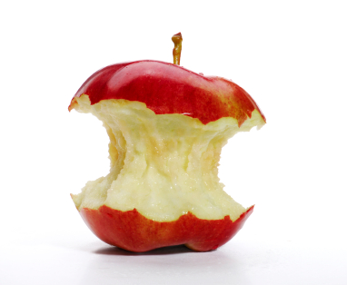
Stay AFSCME Strong to Your Core
Core muscle training helps support your spine, prevents back pain and helps with balance.
Come in to talk with a Physical Therapist or Occupational Therapist about easy core engagement exercises.

Slide 17
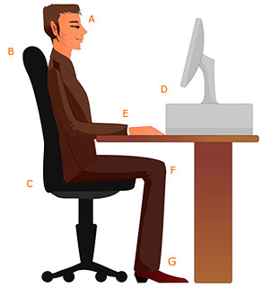
Posture Counts

Slide 18
Posture Counts
A: Eyes looking slightly downward, chin tucked
B: Back supported, lumbar cushion
C: Sit back in seat
D: Monitor 18-24 inches away

Slide 19
Posture Counts
E: Elbows 90 degrees, wrists neutral
F: Hips and knees at 90 degrees, open area behind knees
G: Feet supported (Adjustable chair- may need to adjust computer/table height)

Slide 20
Want to talk proper alignment & movement?
Come in to talk with a Physical Therapist or Occupational therapist about your range of motion issues.
She will show you how to move more efficiently to prevent injury.

Slide 21
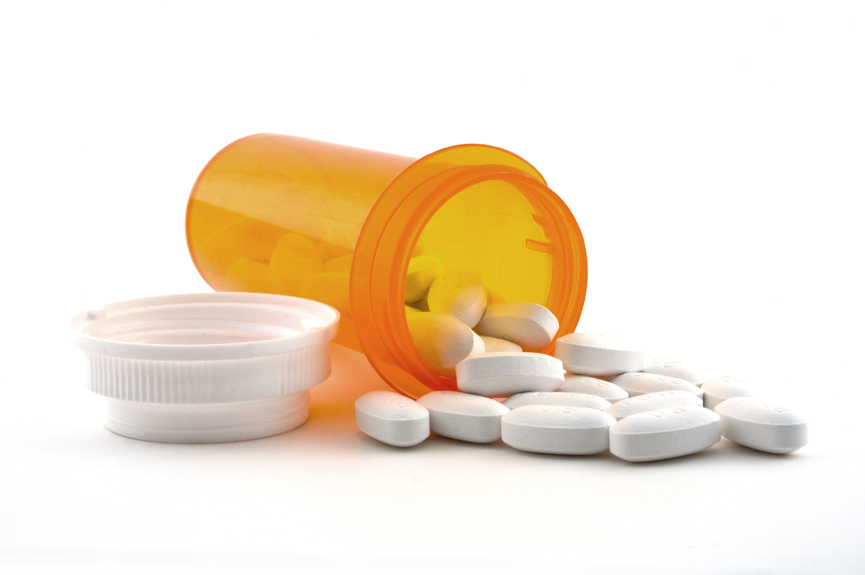
Stay on Top of It!
Maintenance medications can be key to managing your high blood pressure or diabetes.
Come inside to talk to a pharmacist about medication adherence.

Slide 22
Type 2 Diabetes: Are you at risk? Stop by for a risk assessment.
The good news is that you can manage your risk for Type 2 diabetes.
Small steps make a big difference and can help you line a longer, healthier life.
If you are at high risk, your first step is to see your doctor to see if additional testing is needed.

Slide 23
Type 2 Diabetes Common Signs and Symptoms
Urinating a lot
Feeling very thirsty
Feeling hungry all the time
Feeling tired
Blurred vision
Frequent infections or slow healing
Tingling, pain, or numbness in hands or feet

Slide 24
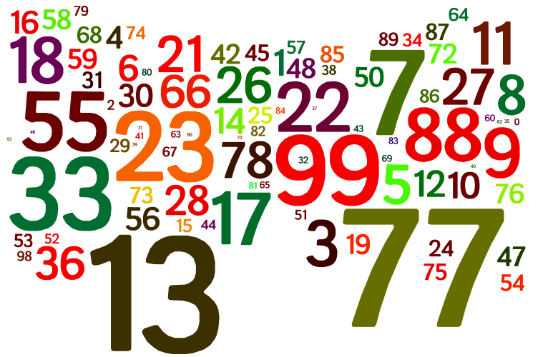
What are your digits?
High blood pressure is a risk factor for heart attack and stroke.
Knowing your blood pressure can help you maintain overall health.
Come in to get your blood pressure checked by a nurse.

Slide 25
Got Women’s Health Questions?
Who needs the HPV vaccine?
How often should I get a Pap smear?
At what age should I get a mammogram?

Slide 26
We’ve Got Women’s Health Answers
Come in to talk with a certified nurse midwife about women’s preventive health guidelines to stay a Well Woman at any age.

